Slide 1
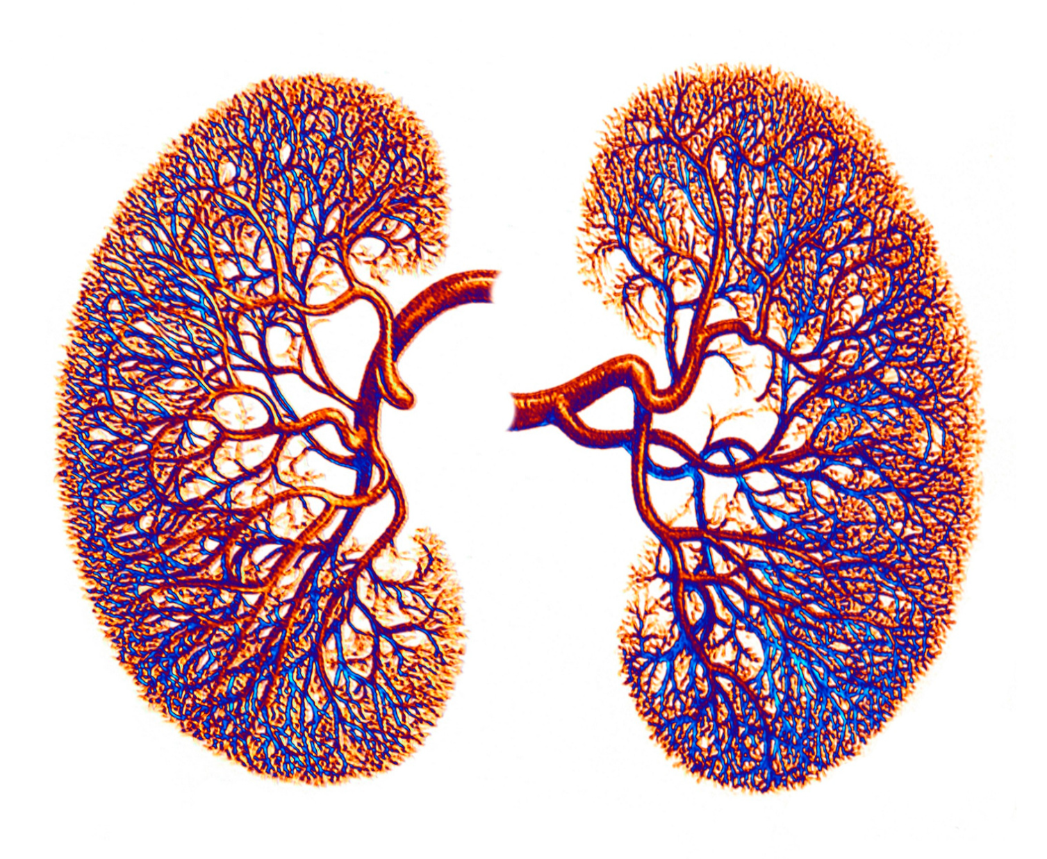
Empagliflozin benefits a broad range of patients with CKD
The EMPA-KIDNEY trial

Slide 2
What is the effect of empagliflozin on patients with CKD?
The challenge with CKD
Investigating the effect of empagliflozin
The finding and its importance
Notes:
This presentation will begin with a brief look at the challenge with managing chronic kidney disease (CKD).

Slide 3
What is the effect of empagliflozin on patients with CKD?
The challenge with CKD
Investigating the effect of empagliflozin
The finding and its importance
Notes:
Next is a deep dive into the EMPA-CKD trial which investigated the effect of treating patients with empaliflozin versus placebo.

Slide 4
What is the effect of empagliflozin on patients with CKD?
The challenge with CKD
Investigating the effect of empagliflozin
The finding and its importance
Notes:
Lastly, the finding and relevance.

Slide 5
CKD progression is a challenge.
Kidney failure
Progression
CKD
Notes:
Chronic kidney disease (CKD) often progresses to kidney failure with a need for renal replacement therapy. Dialysis and kidney transplantation are associated with reduced quality of life, morbidity and mortality.
Decreased eGFR and albuminuria are risk factors for progressive kidney disease.

Slide 6
The need to slow CKD progression remains.
Slowed progression
Kidney failure
CKD
RAS inhibitors
SGLT2 inhibitors
Finerenone
a. Heerspink HJL, et al. N Engl J Med. 2020 Oct 8;383(15):1436-1446
Notes:
Research has demonstrated the ability of drugs like renin angiotensin system inhibitors, sodium-glucose cotransporter 2 inhibitors (SGLT2i) and finerenone to slow CKD progression in patients with diabetes and high-level albuminuria.
Dapagliflozin, an SGLT2i, provided renoprotection to non-diabetic patients with albuminuria in one study. Limited information is available on its efficacy in patients with eGFR<30 ml/min/1.73 m².
Many CKD patients do not have diabetes or significant albuminuria, and an ongoing need to slow CKD progression persists.

Slide 7
Can empagliflozin help?
Effect of once daily empagliflozin on CKD progression, cardiovascular disease and safety.
Diverse patients with CKD
People with and without diabetes
Wide range of eGFR
High and low- level albuminuria
Notes:
The EMPA-KIDNEY study aimed to investigate the effect of empagliflozin on CKD progression, cardiovascular disease and safety in a diverse group of people with CKD. The study population would include people with and without diabetes, those with eGFR of at least 20 ml/min/1.73 m2 and those with high- and low level albuminuria.

Slide 8
Participants with a wide range of eGFR were recruited.
Study participants
Double blinded and placebo controlled
241 centers
8 countries
eGFR
≥20 to <45 ml/min/1.73m²
*eGFR
≥ 45 to < 90 ml/min/1.73m² +
ACR >200mg/g
Polycystic kidney disease
Kidney transplant
*the patient should be on single agent RAS to be eligible
Notes:
The double blinded, placebo-controlled study was conducted in 241 centers in 8 countries. Race adjusted eGFR was calculated using the CKD-EPI formula. Patients with eGFR of at least 20 ml/min/1.73 m² but < 45 ml/min/1.73 m² were eligible to participate. Patients with eGFR of 45 but < 90 ml/min/1.73 m² AND urine ACR > 200 mg/g were also eligible if they were on a single agent renin angiotensin aldosterone inhibitor or couldn’t tolerate RAS. Patients with polycystic kidney disease or a transplanted kidney were excluded from the study.

Slide 9
Primary outcome
First occurrence of kidney disease progression or cardiovascular death
Secondary outcomes
Hospitalization for heart failure or cardiovascular death
All-cause hospitalization
Death from any cause
Kidney disease progression includes commencing maintenance dialysis, receiving a kidney transplant, sustained decline of eGFR to <10 ml/min/1.73 m², sustained decline of eGFR of at least 40% of baseline, or renal death.
Notes:
The primary outcome was the first occurrence of kidney disease progression or death from cardiovascular causes. Kidney disease progression was defined as the initiation of maintenance dialysis, receipt of a kidney transplant, a sustained decrease in eGFR to < 10 ml/min/m² or a sustained decrease of at least 40% from baseline or death from renal causes.
The secondary outcomes were a composite of hospitalization for heart failure or death from cardiovascular causes, all-cause hospitalization, death from any cause.

Slide 10
The study was stopped early after interim analysis.
8544 screened
Follow-up
Median follow up was 2 years
16.9% in the empagliflozin group and 19.4% in the placebo group discontinued treatment by the end of the study
8184 in pre-randomization screening
6609 randomized
3304 in empagliflozin group
3305 in placebo group
Notes:
Eight thousand five hundred and forty four potential participants were screened. Of these, 8184 entered into the prerandomization run in phase and 6609 participants were randomized with 3304 enrolled into the empagliflozin group and 3305 to the placebo group.
The trial was stopped early when the conditions for early stopping were met. The median follow up was 2 years.
By the end of the study, 16.9% of the empaglifozin group and 19.4% of the placebo group discontinued treatment for various reasons.

Slide 11
Patient characteristics were similar in both groups.
Age
Females
White individuals
No prior history of diabetes
63.9 years
33%
59%
54%
The EMPA-KIDNEY collaborative group N Engl J Med. 2023 Jan 12; 388(2): 117–127.
Notes:
The mean age of the study participants was about 63.8 years and 33% of the study participants were females. More than half of the study participants were white individuals and 4% of the study participants were black individuals. Asians made up 36% of the study participants. 54% of the study participants had no prior history of diabetes.

Slide 12
Empagliflozin led to fewer kidney disease progression and cardiovascular death.
Empagliflozin
13.1%
Placebo
16.9%
Outcome | Hazard ratio (Confidence interval)
Kidney disease progression | 0.71 (CI, 0.62-0.81)
Cardiovascular death | 0.84 (CI, 0.60-1.19)
End stage kidney disease or death from CV causes | 0.73 (CI, 0.59-0.89)
HR, 0.72; CI, 0.78-0.95
End stage kidney disease: initiation of maintenance dialysis or receipt of a kidney transplant.
Notes:
The primary outcome of kidney disease progression and cardiovascular death occurred less frequently in the empagliflozin group (13.1% versus 16.9%, HR, 0.72). Comparing empagliflozin to placebo for each outcome, the hazard ratio for kidney disease progression was 0.71, cardiovascular disease was 0.84, and hazard ratio for end stage kidney disease was 0.73.

Slide 13
The benefit of empagliflozin on kidney disease progression and CV death was demonstrated in subgroups.
Subgroup
Empagliflozin
Placebo
Hazard ratio(95% CI)
No of participants/total no
Empagliflozin better
Placebo better
The EMPA-KIDNEY collaborative group N Engl J Med. 2023 Jan 12; 388(2): 117–127.
Notes:
The superior benefit of empagliflozin on kidney disease progression and cardiovascular death was demonstrated in all subgroups including patients without diabetes and those with eGFR < 30 ml/min/1.73 m².

Slide 14
The benefit of empagliflozin on kidney disease progression and CV death was demonstrated in subgroups.
Subgroup
Empagliflozin
Placebo
Hazard ratio(95% CI)
No of participants/total no
Empagliflozin better
Placebo better
The EMPA-KIDNEY collaborative group N Engl J Med. 2023 Jan 12; 388(2): 117–127.
Notes:
Risk reduction with empagliflozin appears to be higher in those with urine ACR ≥300 mg/g

Slide 15
Empagliflozin led to significantly fewer all-cause hospitalization.
Outcome | Hazard ratio | P-value
All-cause hospitalization | 0.86 (CI, 0.78-0.95) | 0.003
Hospitalization for heart failure or CV death | 0.84 (CI, 0.67-1.07) | 0.15
Death from any cause | 0.87 (CI, 0.70-1.08) | 0.21
Notes:
Empagliflozin led to significantly fewer all-cause hospitalization with a HR of 0.86 and CI of 0.78-0.95. Analysis of all-cause hospitalization included first and subsequent events.

Slide 16
The overall rate of decline in eGFR was slower in the empagliflozin group.
The EMPA-KIDNEY collaborative group N Engl J Med. 2023 Jan 12; 388(2): 117–127.
Notes:
On commencing empagliflozin, there was a sharp drop in eGFR, but this was followed by slowed decline. Overall, the difference in total slope between both groups was 0.75 (CI, 0.54-0.96).

Slide 17
Empagliflozin appeared relatively safe.
The EMPA-KIDNEY collaborative group N Engl J Med. 2023 Jan 12; 388(2): 117–127.
Notes:
Empagliflozin appeared relatively safe and the frequency of adverse events was similar in both groups. Although there was more bone fracture, lower limb amputation and dehydration in the empagliflozin group, it was not statistically significant. Ketoacidosis occurred in 6 patients in the empagliflozin group representing 0.09 events per 100-patient years. One person in the placebo group experienced ketoacidosis representing 0.02 events per 100-patient years.
Overall, there was no significant difference in the occurrence of adverse events between both groups.

Slide 18
Going beyond CREDENCEª and DAPA-CKD^{b} trials.
28% reduction in risk of kidney disease progression or cardiovascular death.
14% reduction in risk of hospitalization from any cause.
Benefits seen in patients with a broad range of eGFR regardless of diabetes status.
Perkovic V. et al. N Engl J Med. 2019 Jun 13;380(24):2295-2306.
Heerspink HJL, et al. N Engl J Med. 2020 Oct 8;383(15):1436-1446.
Notes:
The CREDENCE and DAPA-CKD trials had previously shown the benefits of SGLT2 inhibitors on kidney disease progression or death from cardiovascular causes. This study showed similar results as empagliflozin led to a 28% reduction in risk of kidney disease progression and cardiovascular death in diverse patients with CKD. Empagliflozin treatment was also associated with a 14% reduction in risk of hospitalization from any cause.
The CREDENCE and DAPA-CKD trials had previously shown the benefits of SGLT2i in patients with CKD. The CREDENCE study required study participants to have type 2 diabetes and urine ACR ≥ 300 mg/g. The DAPA-CKD required participants to have urine ACR of at least 200 mg/g. The minimum eGFR in the CREDENCE study was 30 ml/min/1.73 m2 and that of DAPA-CKD trial was 25 ml/min/m2. The EMPA-CKD study adds to existing evidence by demonstrating these benefits in patients with a broad range of eGFR regardless of diabetes status.

Slide 19
Study strength and limitations.
STRENGTHS
Large size
*Diverse patients
Good adherence
LIMITATIONS
Reduced statistical power to assess secondary and tertiary cardiovascular outcome
Notes:
The strengths of this study are its large size, wide range of patient profile and good adherence. Its limitation is the low rate of cardiovascular events that reduced the statistical power to assess secondary and tertiary cardiovascular outcome.

Slide 20
Empagliflozin can help individuals with CKD.

